Slide 1
ACSM American Fitness Index
Actively Moving America to Better Health
2019
Notes:
As a signature initiative of the American College of Sports Medicine, the American Fitness Index aligns with the College’s work to address health and fitness through research and education. The Fitness Index’s long-time, sole sponsor is the Anthem Foundation, which has given more than 1 million dollars since 2006.

Slide 2
Overview of the Fitness Index
Ranks the 100 most populous cities in America
Analyzes 33 indicators to assess community fitness
Health behaviors
Health outcomes
Built environment
Recreational assets
Local policy & funding
Focuses on a policy, systems, and environment change model
Notes:
The American Fitness Index ranks cities on their community fitness, a concept analogous to individuals having strong personal fitness. Cities that rank near the top of the Fitness Index have more strengths and resources that support healthy living and fewer challenges that hinder it.
The Fitness Index uses the annual rankings to encourage city leaders to enact policies and make systems changes to promote healthy, active lifestyles.
[NOTE: The primary data sources for the Fitness Index are the CDC’s Behavioral Risk Factor Surveillance Survey (BRFSS) and Trust for Public Lands.]

Slide 3
Fitness Index Approach
Inform
Demonstrate health, social, and economic benefits
Engage
Celebrate local factors contributing to health and fitness
Build
Implement policy and infrastructure changes
Notes:
The Fitness Index focuses on three strategies to help cities:
1. Inform: Demonstrate the health, social, and economic benefits of physical activity as well as the policies and infrastructure that promote healthy behaviors.
2. Engage: Inspire city leaders and residents to celebrate the factors that contribute to their city’s culture of health and fitness. Every city is doing something to improve and promote its residents’ health.
3. Build: Expand local capacity and partnerships to implement policy and infrastructure changes to facilitate a physically active lifestyle for all residents.

Slide 4
Policy, Systems, & Environment (PSE) Change Model
Policy
Environment
Changes that affect elements of an organization, institution, or system
Physical or material changes to the economic, social, or physical environment
Systems
Laws, ordinances, resolutions, mandates, regulations, or rules (both formal & informal)
Healthy People
Personal behavior, health outcomes
Notes:
Improving the health and physical activity of cities requires a systematic approach that includes policy, systems, environment, and behavior changes. While this approach takes more time and effort, the effects last longer than one-time programs or short-lived campaigns.

Slide 5
Notes:
Healthy, active cities don’t occur in a vacuum. A culture of health is created when urban planning (or city design), local policies and funding, and health promoting behaviors intersect. After all, the journey to a healthier future begins where we live, learn, work, and play.

Slide 6
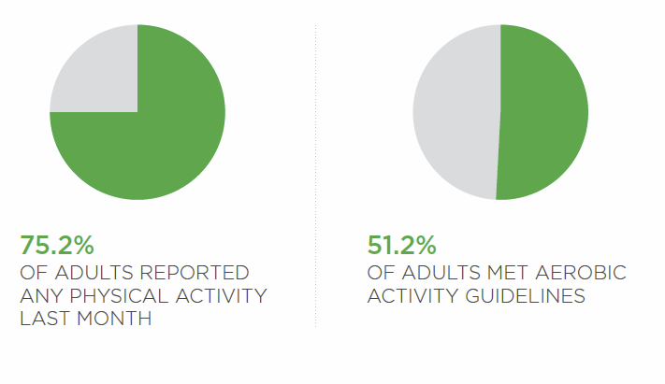
2019 Fitness Index Rankings & Findings
Top 10 Fittest Cities
Arlington, VA
Seattle, WA
Minneapolis, MN
San Francisco, CA
Madison, WI
Washington, D.C.
St. Paul, MN
Irvine, CA
Denver, CO
Portland, OR
*100 city averages
Notes:
An analysis of this year’s indicators revealed that among the 100 most populous cities, an average of 75% of residents reported any physical activity in the previous month (not related to their jobs). That number is down from 2018 when approximately 78% of residents reported were active.
Only 51% of adults met the recommendations for aerobic activity. (150 minutes per week of moderate activity) and only 22% met the guidelines for both aerobic and strength activity. Even fewer, only 5% of residents walk or bike to work. These numbers are unchanged from 2018.
All of this is evidence that American cities have room to improve their residents’ physical activity levels, and therefore their overall health and productivity.

Slide 7
2019 Findings – Continued
Notes:
The Fitness Index scores show that adult are meeting recommendations for eating fruit at the same rate as 2018, but there was a slight decrease in the percent of adults meeting the recommendations for vegetable which are down 2% from 2018.
The Fitness Index scores also illuminate health equity issues in the built environment. For example, access to healthy food varies widely across cities. While there are an average of 19 farmers’ markets per 1 million residents, the range of farmers’ markets is 82 per 1 million residents (Washington, D.C.) on the high end to 0 farmers’ markets on the low end (Plano TX, Hialeah FL, Garland TX, Aurora CO, Irving TX, Gilbert AZ).

Slide 8
2019 Findings – Continued
Notes:
Access to safe, affordable places to be physically active also varies widely by city, and in some cases, by neighborhood. On average 66% of city residents live within a 10-minute walk to a park, however in cities ranked in the Fitness Index’s top 25, more than 84% of residents live within a 10-minute walk to a park.
As mentioned previously, the built environment matters, and unequal development of activity facilities affects some residents more than others. Studies have shown that wealthier neighborhoods are more likely to have access to parks, trails, greenways, and blue ways (rivers, lakes, canals) than poorer neighborhoods.
It’s important to remember that a majority of the indicators do not change rapidly, and it will take time for the impact of new initiatives to result in changes to health indicators. While improvements in community and built environment indicators are important investments, a notable change in the health of residents is expected to slowly but surely follow.

Slide 9
Media Advocacy
Notes:
Dissemination of the Fitness Index has been, and continues to be, wildly successful. These efforts are aimed at raising awareness of what cities are doing well and where they have room for improvement. On average, an estimated 355 million people are reached through traditional media and social media.
This year the Fitness Index was included in several high-profile, nationally recognized publications with wide readership that fueled Fitness Index’s exposure. Stories included an exclusive story in USA Today, NBC News, U.S. News and World Report, Today.com, and TIME magazine.
A robust communications plan helps the Fitness Index receive year-round coverage from local news outlets like the Seattle Times, Colorado Public Radio and Cronkite News in Arizona.

Slide 10
Getting Involved
Be a role model for good health and physical activity
Volunteer your expertise by joining a local coalition dedicated to encouraging physical activity
Educate community leaders and bring awareness to the physical inactivity epidemic in your community
Advocate that community leaders take a proactive approach to solving challenges in your community
Notes:
Cities need local advocates to raise awareness and to advocate for policies and infrastructure that supports a healthy, physically active lifestyle. You don’t have to run for public office to have a significant impact in your city. Here are some ways to get involved.

Slide 11
Thank you
Learn more at www.americanfitnessindex.org
Follow the ACSM American Fitness Index on social media
Twitter: @ACSMFitIndex #100FitCities
Facebook: ACSM American Fitness Index

